Slide 1
Witch Treehouse Diorama
Lycia Stenson

Slide 2
Nightbird Engine
C++ 17, OpenGL 4.6
Libraries
GLFW – Cross-platform window library (Zlib License)
glm – Maths library (MIT License)
stb image – Image loading library (MIT License)
fastgltf – glTF model loader (MIT License)
Flecs – Entity Component System (ECS) library (MIT License)

Slide 3
Nightbird Engine
Premake
premake5.exe vs2022
Diorama/Assets -> out/bin/debug-windows-x86_64/Diorama
Controls
WASD + mouse
M – Toggle shadow mapping
N – Toggle normal mapping
B – Toggle water wireframe
V – Toggle directional light spin

Slide 4
Model Importing
Importing binary glTF models

Slide 5

Model Importing
The glTF standard was chosen for model importing
Open standard
Scenes
Nodes
Meshes
Primitives
Attributes
POSITION
NORMAL
TEXCOORD_X
Materials
Textures
glTF Logo (Khronos Group, 2016)
glTF 2.0 Specification (Khronos Group, 2021)

Slide 6
Model Importing – fastgltf
A fast, modern C++ 17 glTF 2.0 importer
Can import multiple glTF setups
.gltf with external image files
.gltf with images encoded in the JSON
.glb binary format with encoded images
glTF Logo (Khronos Group, 2016)

Slide 7
Model Importing – Implementation
Only importing .glb binary files was implemented
Sketchfab provides models in the .glb format
The glTF node hierarchy is translated to an entity transform hierarchy
Resource Manager
Meshes and textures imported once
Instantiated from prefab
glTF Logo (Khronos Group, 2016)

Slide 8
Render Target
Modular rendering

Slide 9
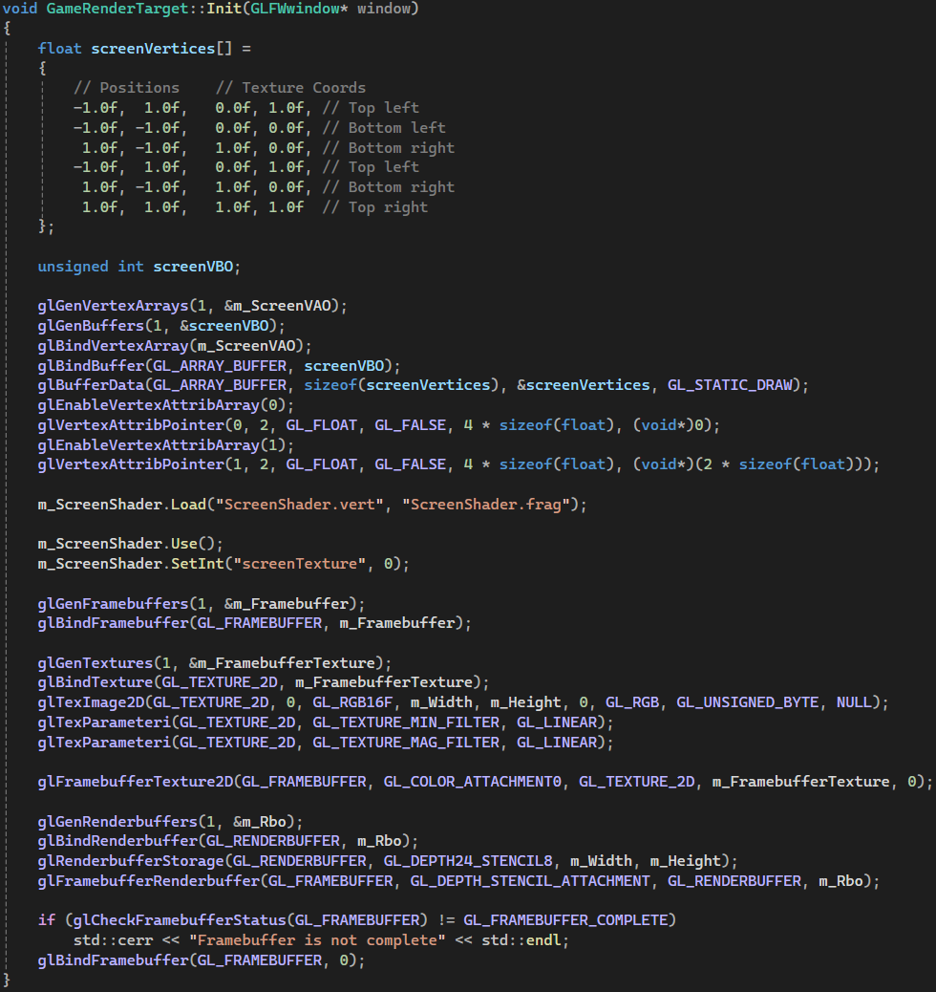
Render Target
Abstract class
Different implementations allow for rendering to different targets
Game render target renders to the main window
Nightbird editor render target renders to a Dear ImGui editor window
Generates screen vertex array object, framebuffer, and render texture

Slide 10
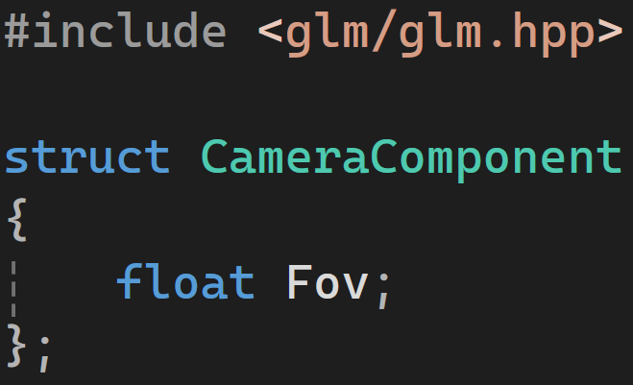
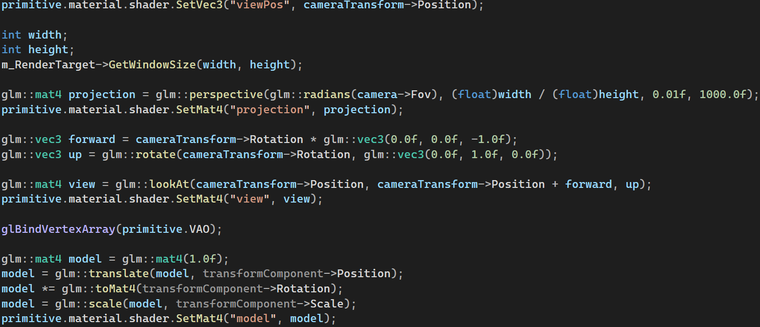
Camera
Attaching a CameraComponent to an entity creates a camera
The component itself only holds the FOV
The camera entity also requires a Global and Local TransformComponent
The position and rotation from these are used in the render systems to create the view matrix

Slide 11
Mesh Rendering
Rendering through ECS systems

Slide 12
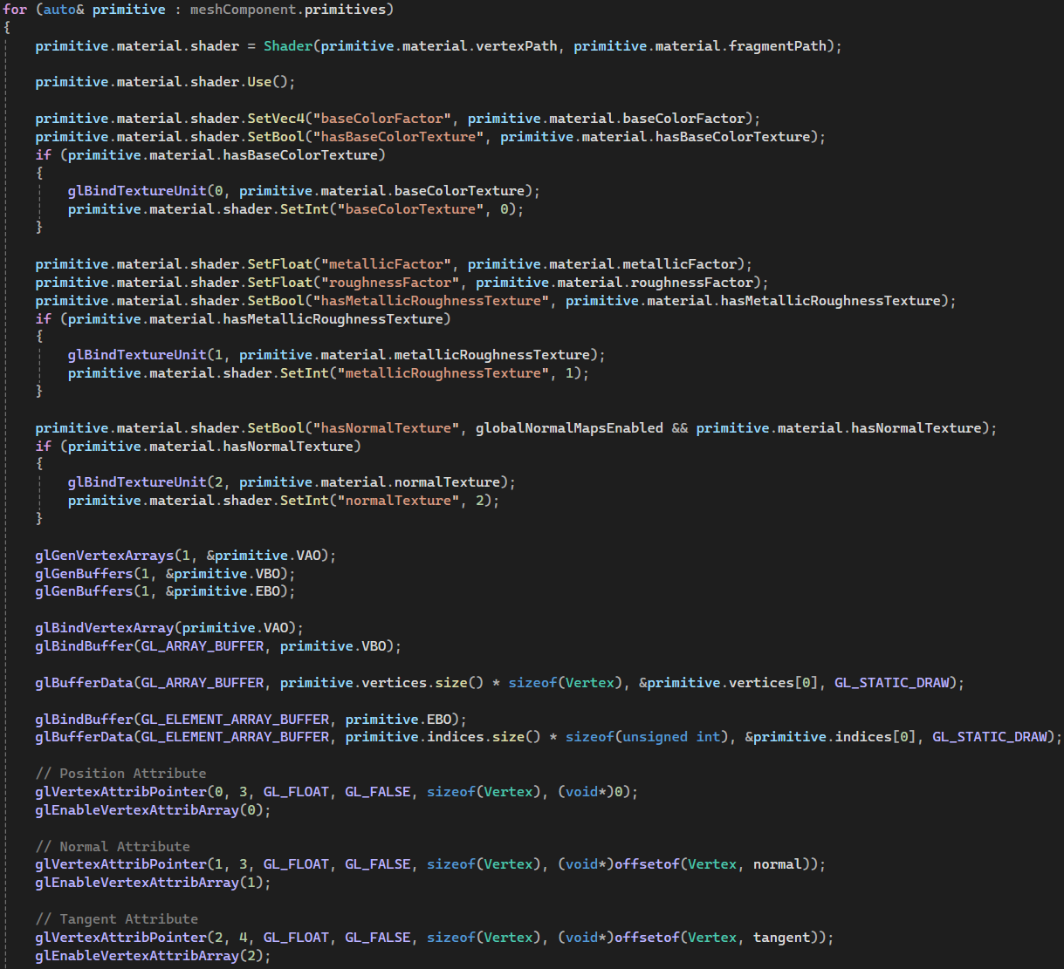
Mesh System – Initialisation
Iterate mesh primitives
Shader uniforms
Textures
‘hasTexture’ Booleans
Generate
Vertex array objects
Vertex buffer objects
Element buffer objects
Vertex attribute pointers
Position, normal, tangent, base colour texture coord, metallic roughness texture coord, normal texture coord

Slide 13
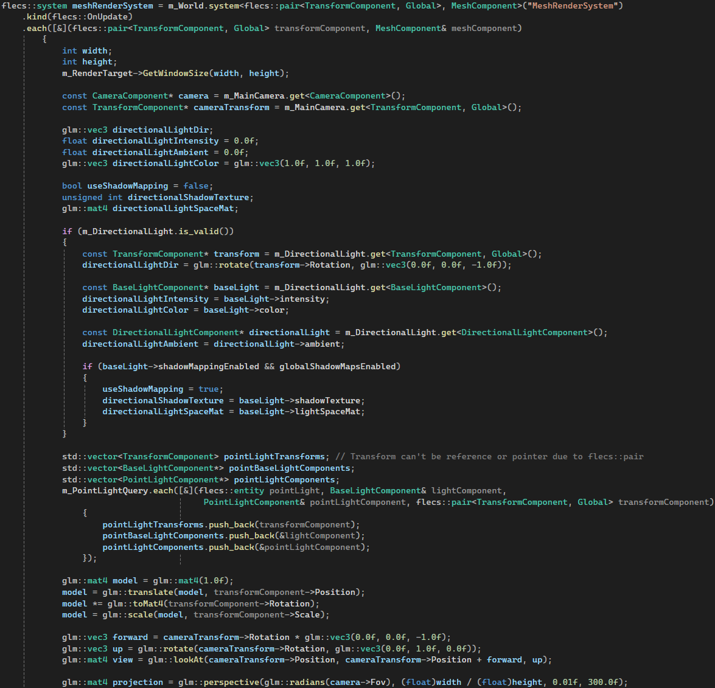
Mesh System – Rendering
Fetch relevant world data
Camera transform
Directional light information
Point lights information
Model, view, projection matrices
Fetched once before iterating all mesh primitives

Slide 14
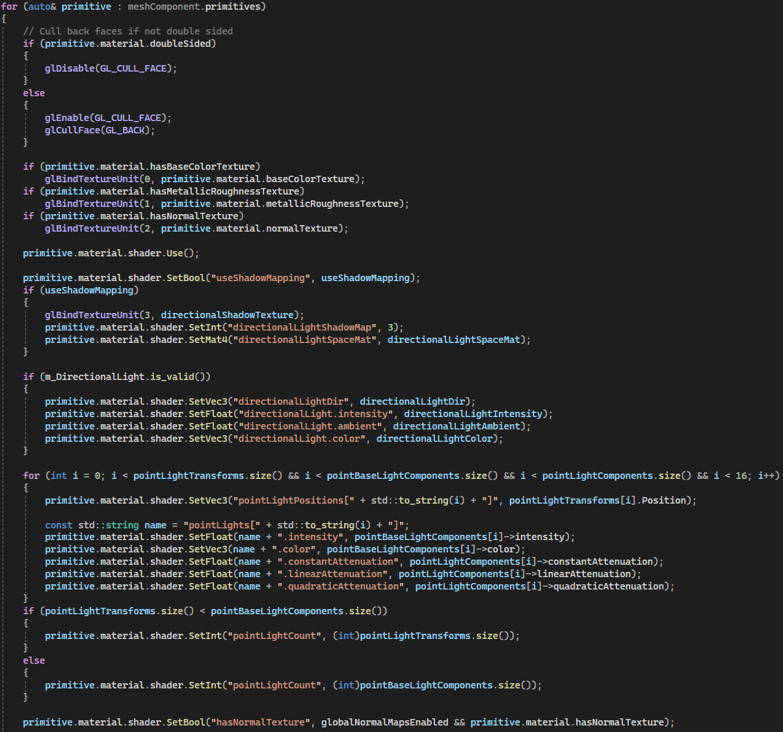
Mesh System – Rendering
Iterate mesh primitives
Cull back faces if not double sided
Bind texture units for each texture
Update shader uniforms with directional and point light data

Slide 15
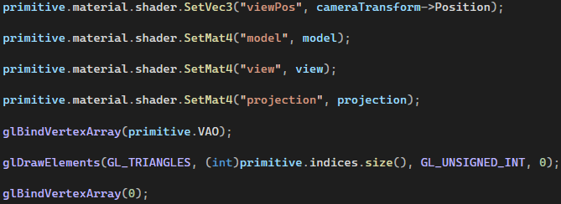
Mesh System – Rendering
Set shader uniforms
View position
Model, view, projection matrices
Bind mesh primitive’s vertex array object
Draw elements using primitive’s indices
Unbind vertex array object

Slide 16
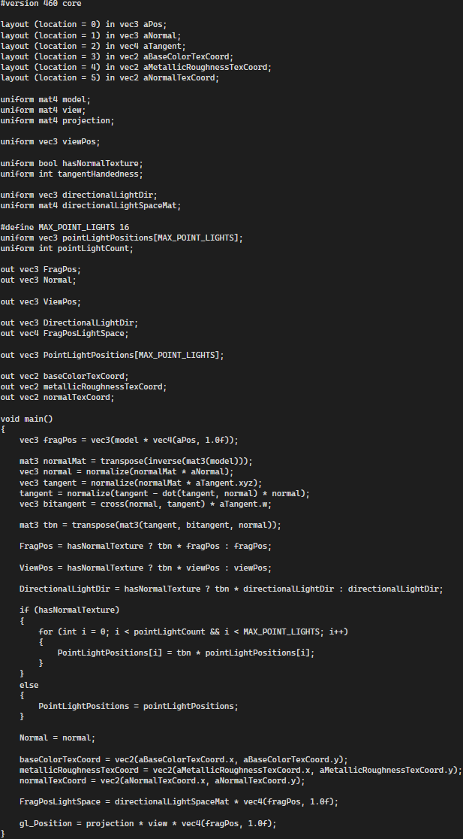
Mesh Vertex Shader
Constructs a tangent bitangent normal (TBN) matrix
If the mesh uses a normal map, lighting information is transformed to tangent space using the TBN matrix
Otherwise, the lighting information remains in world space

Slide 17
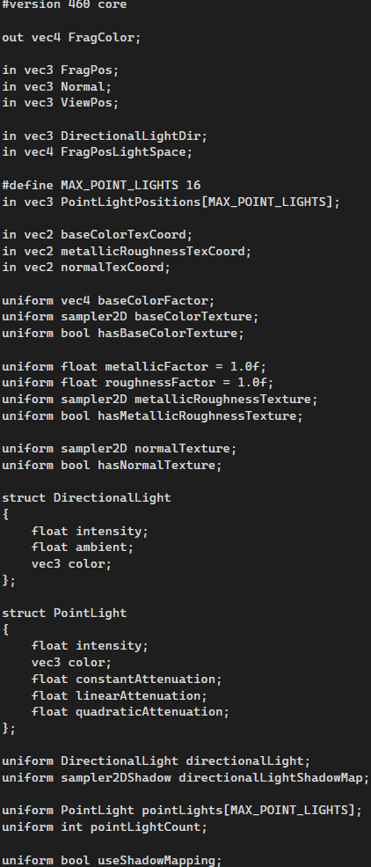
Mesh Fragment Shader – Uniforms
Structs for directional and point light information
Separate direction variables passed from vertex shader in world/tangent space depending on presence of normal map
Uniform booleans for presence of textures and use of shadow mapping

Slide 18
Skybox Rendering
Rendering cube map through ECS systems

Slide 19
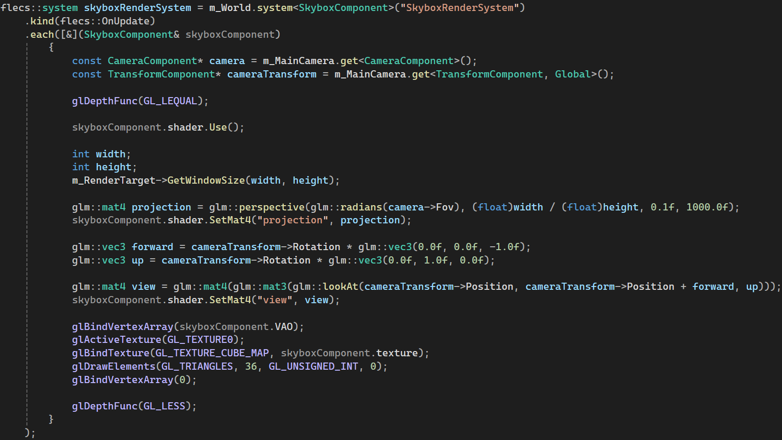
Skybox Systems
Similar to the mesh systems
Threaded texture loading
Init system triggers async texture loading
Late init system checks on update if all textures are loaded, and then registers them to OpenGL
Only a position vertex attribute is created
The 3D position is directly used to sample the cube map without UVs

Slide 20
Lights
Directional and point lights
Shadow mapping

Slide 21
Lights
Three main types of lights
Directional light
Point light
Spotlight
Implemented directional and point lights

Slide 22
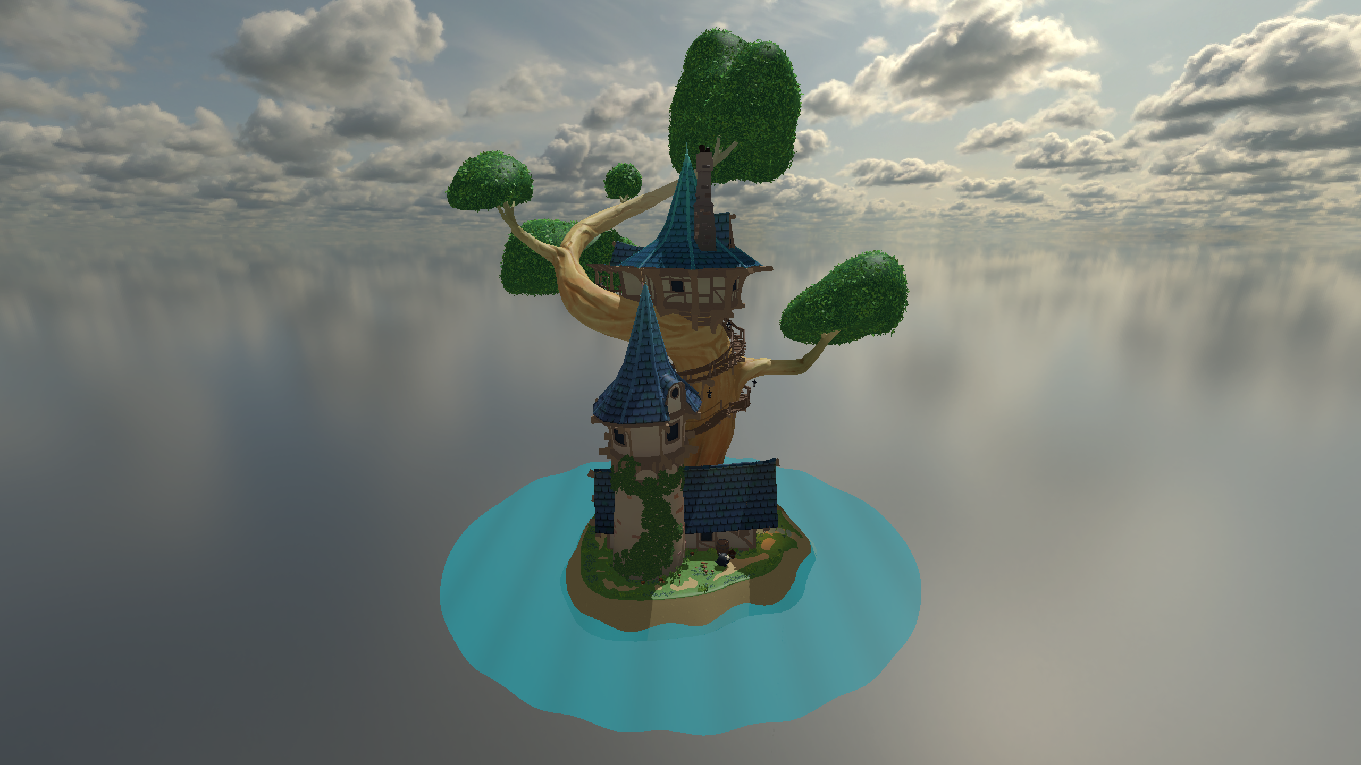
Directional Light

Slide 23
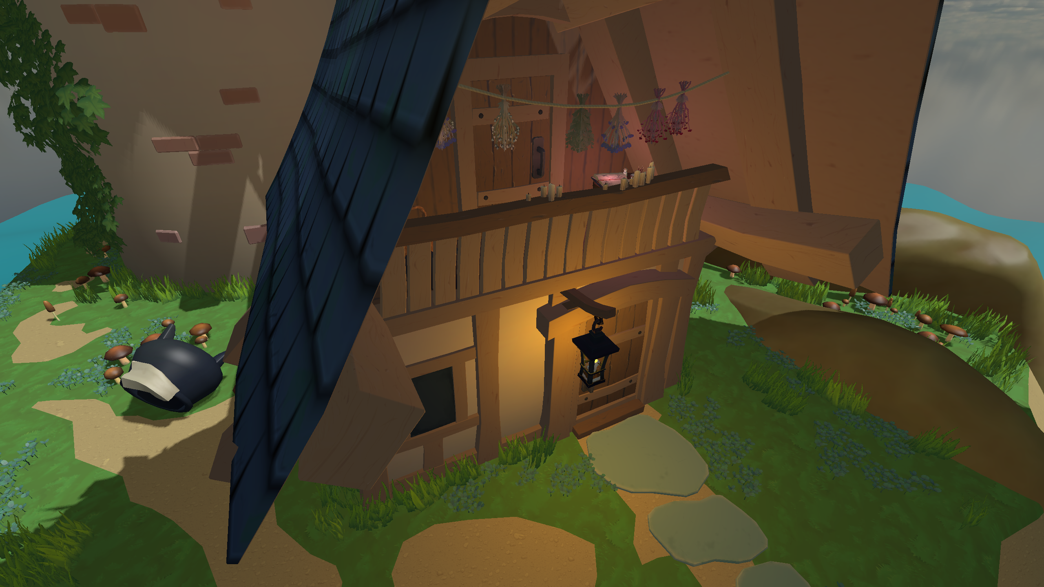
Point Lights

Slide 24
Gamma Correction
Base colour textures are encoded with the sRGB standard
Non-linear brightness to match human perception
Lighting calculations should be done in a linear colour space to be physically accurate

Slide 25
Shadow Mapping
The scene is rendered from the point of view of the light
Directional Light – Orthographic camera
Spotlight – Perspective camera
Point Light – Cube map
Implemented for the directional light only due to time constraints

Slide 26
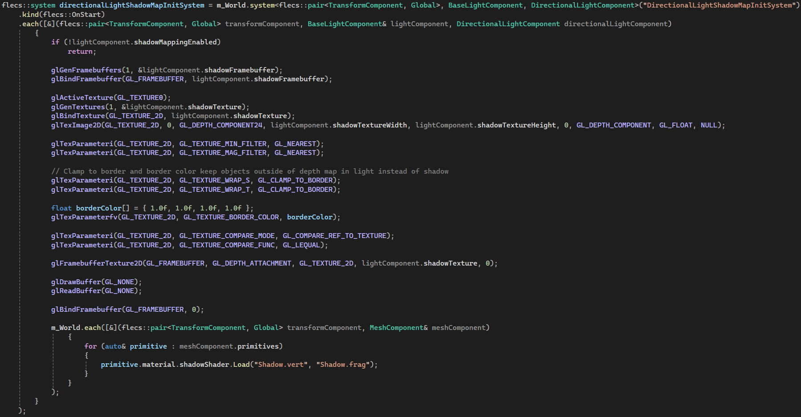
Shadow Mapping – Initialisation
Generate framebuffer like regular rendering
Generate texture
GL_DEPTH_COMPONENT instead of GL_RGB
Clamp to border colour
Objects outside of depth map are treated as in light not shadow
Draw and read buffer disabled as colour not needed, only depth

Slide 27
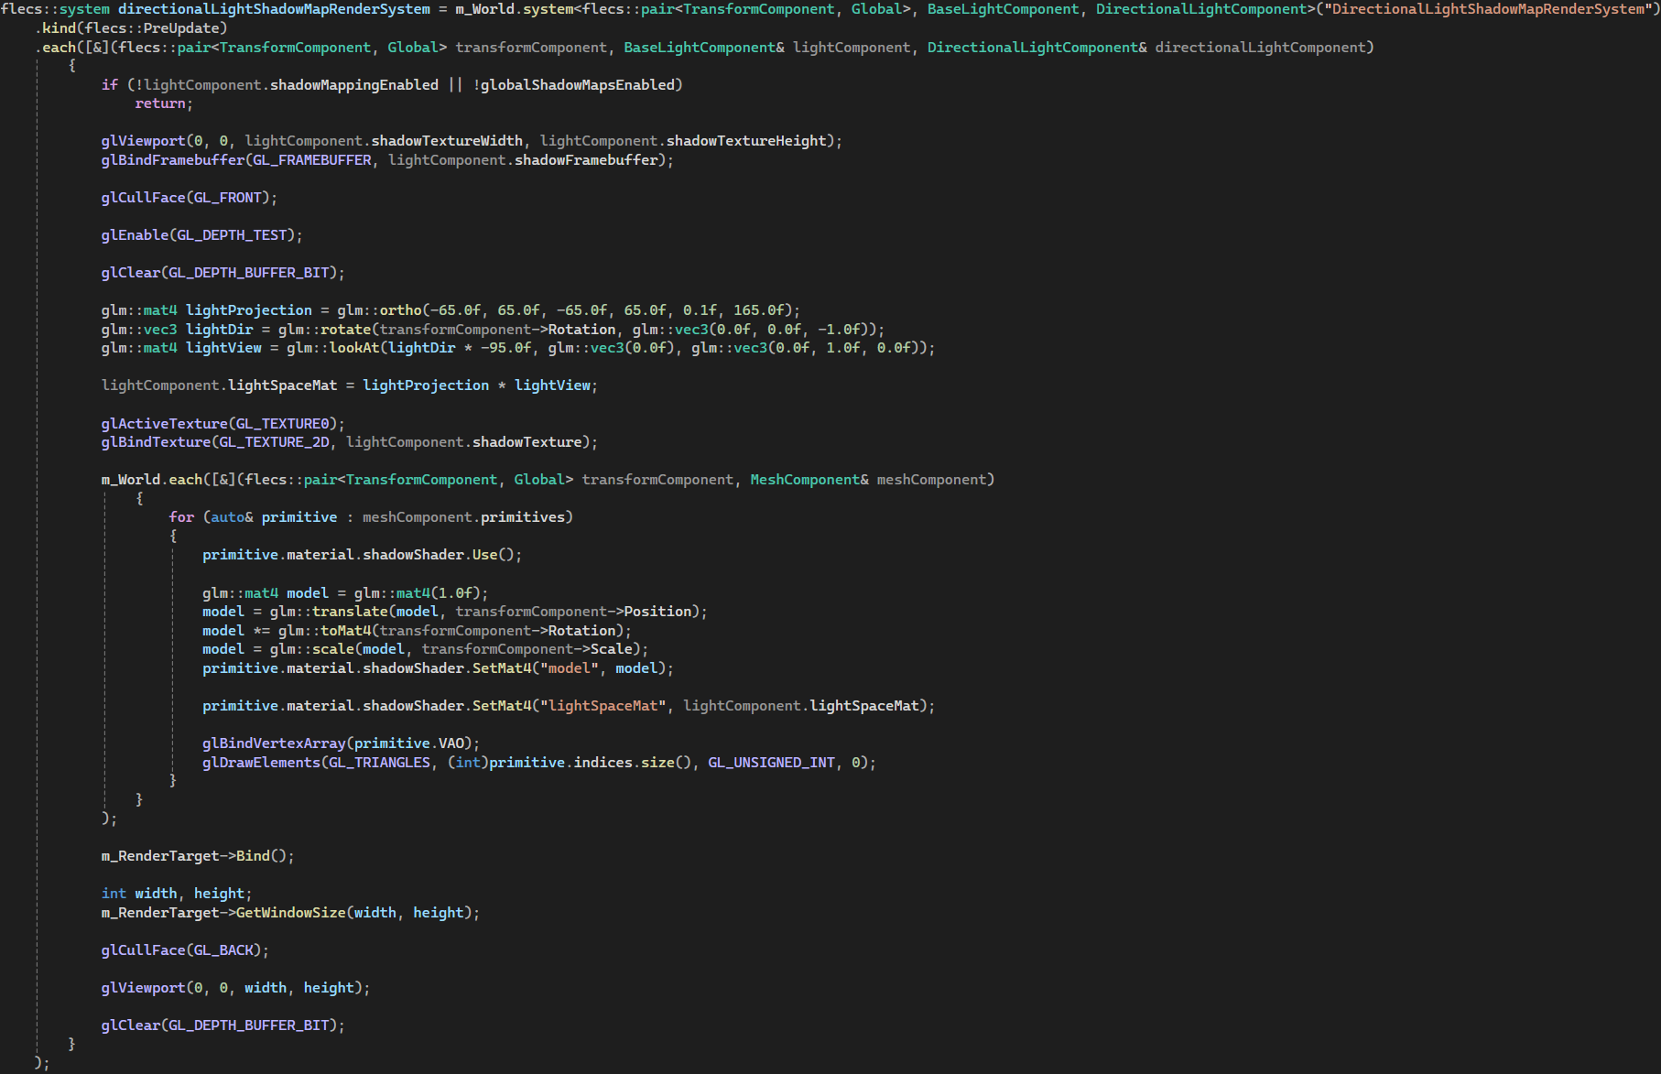
Shadow Mapping – Rendering
Switch viewport to shadow resolution
Bind light’s shadow framebuffer
Cull front faces instead of back faces
Counteracts shadow acne
Bind light’s shadow map texture
Draw elements

Slide 28
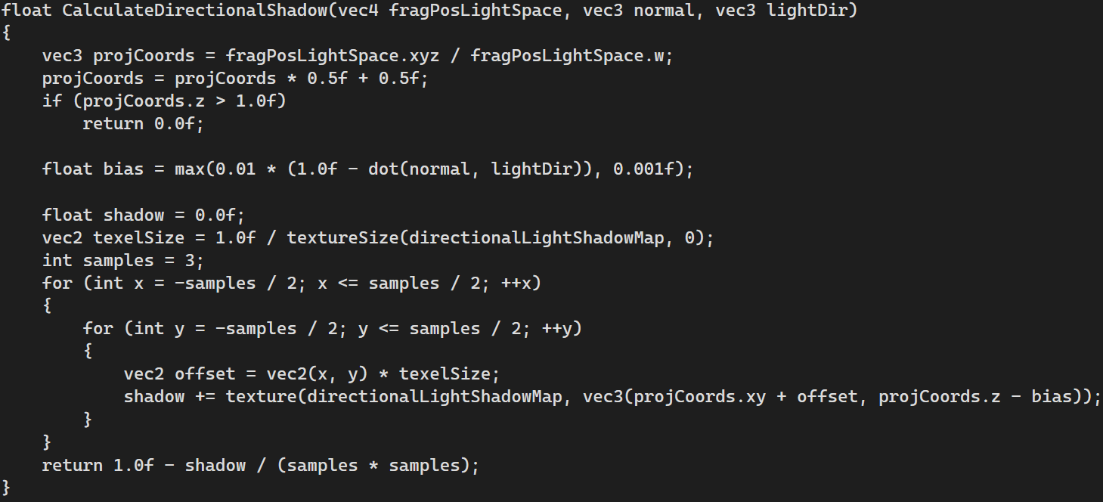
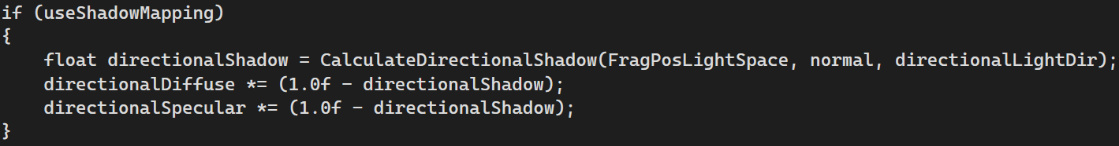
Mesh Fragment Shader – Shadow calculation
Fragment position in light space
Passed from vertex shader
Calculated using light space matrix uniform variable
Compare depth of fragment to depth in shadow map depth buffer
If the fragment has a greater depth than the depth buffer, it is behind an object closer to the camera and should be in shadow
By using sampler2DShadow, OpenGL handles this comparison

Slide 29
Tessellation
Tessellated quad water

Slide 30
Tessellation
The water is a single quad
Fragments beyond a radius are discarded

Slide 31
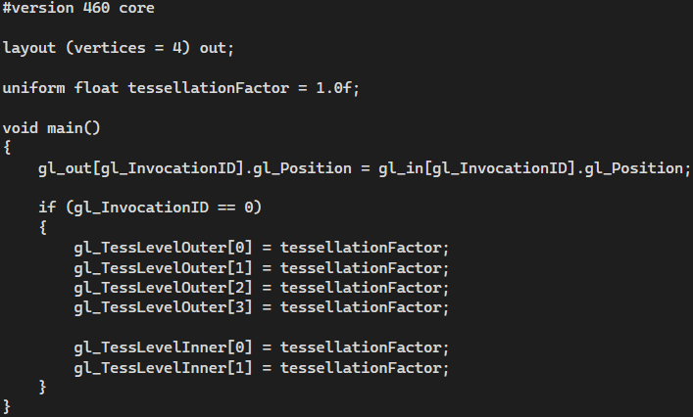
Tessellation Control Shader
Sets the inner and outer tessellation levels based on a uniform float
This factor could depend on the distance from the camera allowing for dynamic tessellation
For a small diorama this is less of a concern

Slide 32
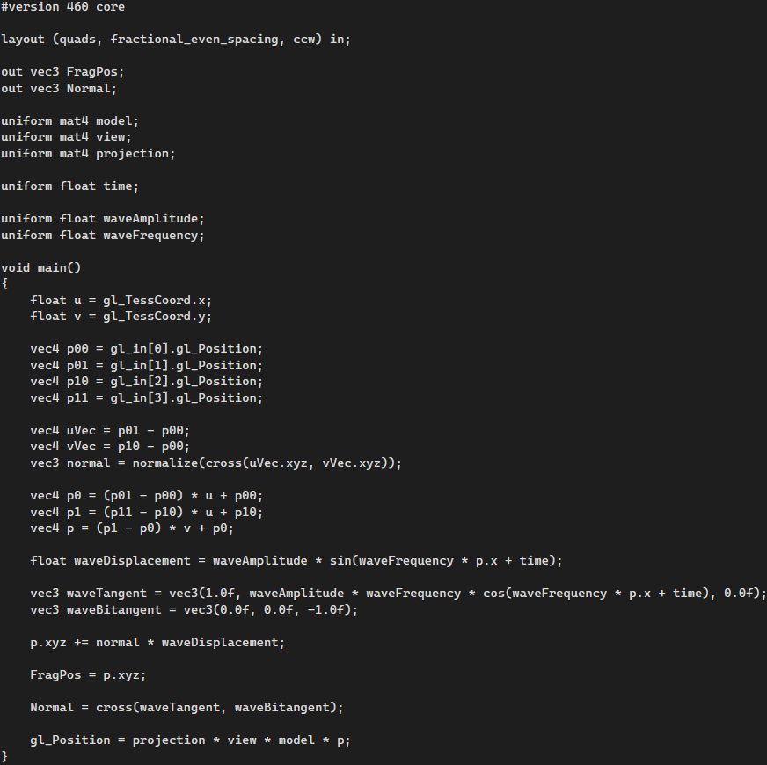

Tessellation Evaluation Shader
Uniform variables
Model, view, projection
Time
Wave amplitude and frequency
The tessellated points are displaced by a sin wave with the x coordinate plus time, multiplied by amplitude
The tangent is calculated using the derivative of the wave function
$\frac{d}{dx}a\sin{(fx+t)}=af\cos{(fx+t)}$
The normal is calculated as the cross product of the tangent and bitangent

Slide 33
Shading
Investigating physically-based rendering

Slide 34
The Rendering Equation
Outgoing Light
= Emitted Light +
Reflected Light

Slide 35
The Rendering Equation
Reflected Light

Slide 36
The Rendering Equation
Diffuse Reflection
Specular Reflection

Slide 37
Diffuse Reflection
Light absorbed by surface, reflected in all directions
Lambertian diffuse
Burley diffuse (Burley, 2012)
Unreal chose to use Lambertian diffuse for efficiency (Karis, 2013)

Slide 38
Specular Reflection
Light reflected directly
Phong model
Specular reflection calculated using dot product of view vector and reflection vector
Blinn-Phong model
Calculates halfway vector between view vector and light direction
Specular reflection calculated using dot product of normal and halfway vector
More computationally efficient

Slide 39
References
Khronos Group (2021) glTF™ 2.0 Specification [Version 2.0.1]. Available at: https://registry.khronos.org/glTF/specs/2.0/glTF-2.0.html (Accessed: 24 January 2025)
Apelar, S. (2025) fastgltf example gl_viewer.cpp. Available at: https://github.com/spnda/fastgltf/blob/main/examples/gl_viewer/gl_viewer.cpp (Accessed 6 January 2025)
Alexander, M. (2019) Witch Treehouse. Available at: https://sketchfab.com/3d-models/witch-treehouse-306e5b56f2fa458c822813a07dd62e84 (Accessed: 30 January 2025)
Guest, J. and Majboroda, S. (2023) Sunflowers (Pure Sky). Available at: https://polyhaven.com/a/sunflowers_puresky (Accessed: 27 October 2024)

